Slide 1
Agenda for today:
Brief recap of last week
Discussion of papers:
Group 1, Group 2, whole class
Code Grading
Simulating Drift
Short reads, QC, slurm

Slide 2
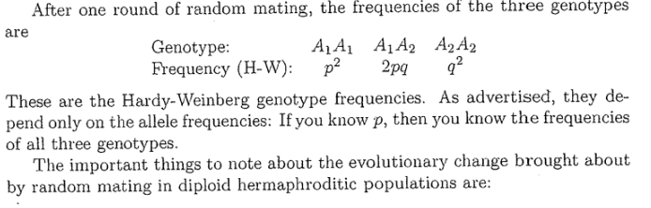
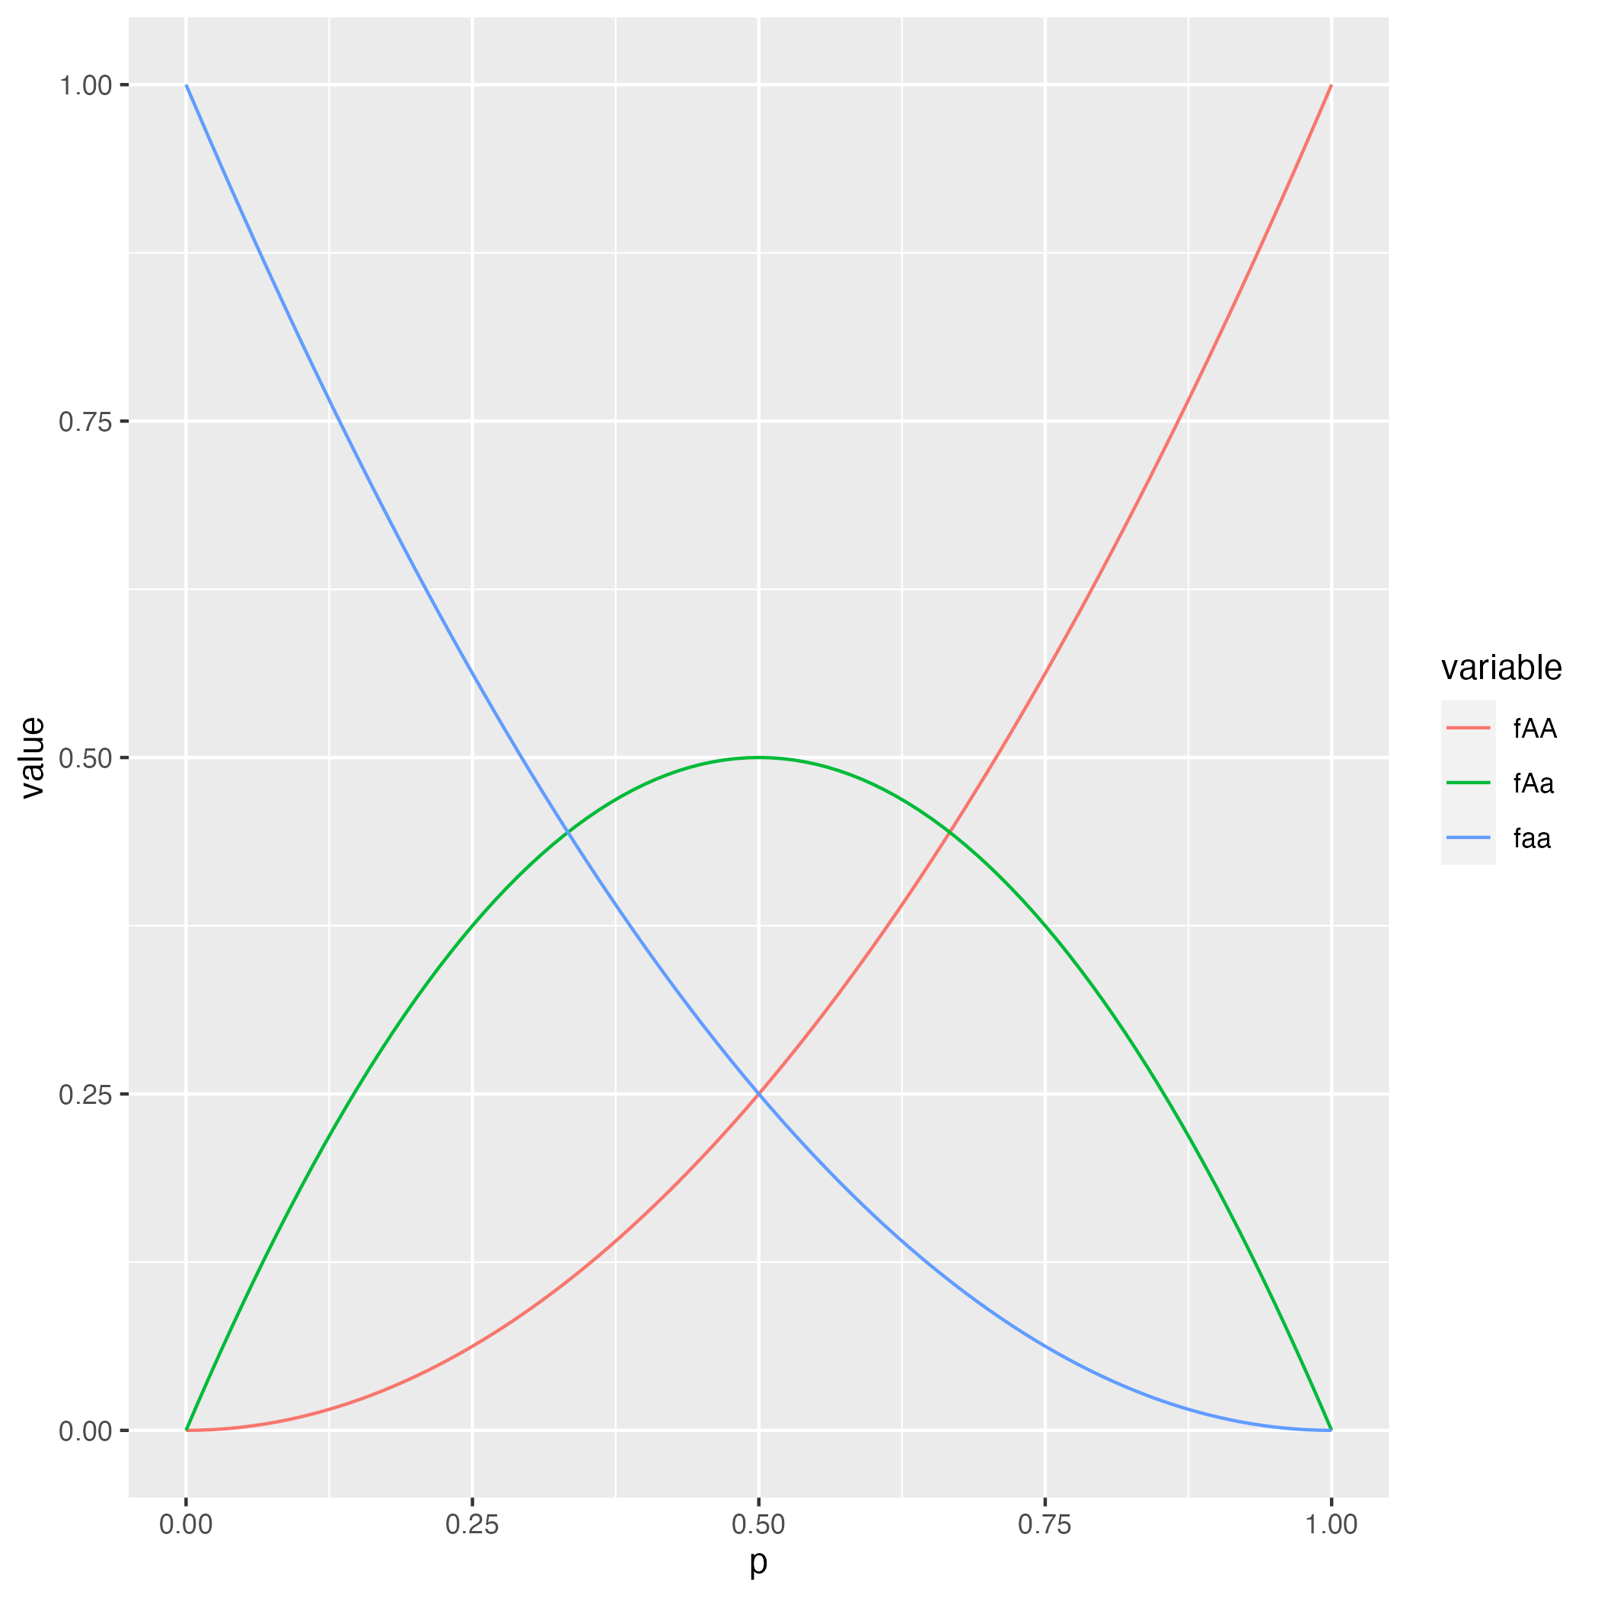
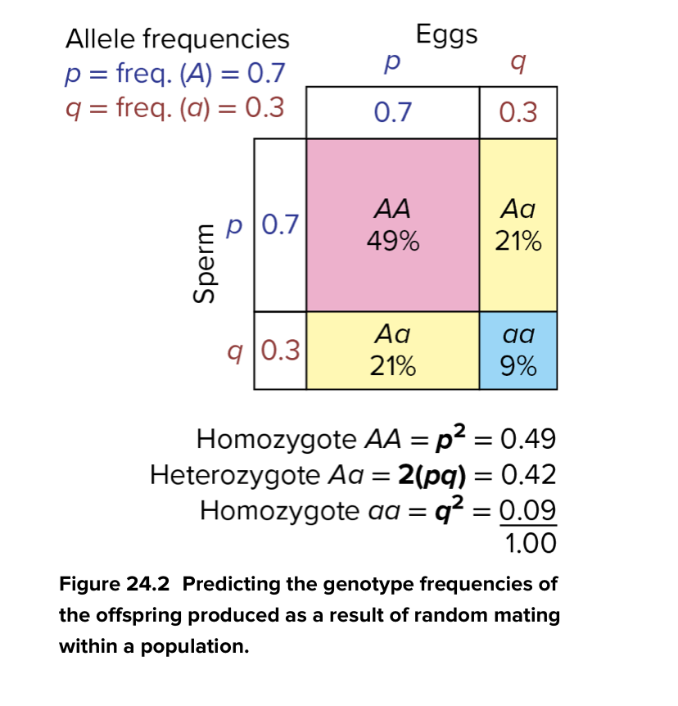
The HWE model is one of the most simple models in population genetics

Slide 3
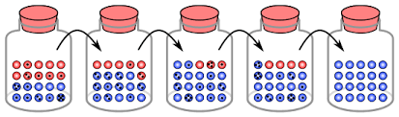
Another basic model: Drift

Slide 4
Artificial selection experiments
• Using artificial selection, we can create populations of organisms that are very different from their ancestors.
• One classic experiment is corn-oil
• Another amazing example is fox-domestication
• Drosophila can be used for artificial selection too.

Slide 5
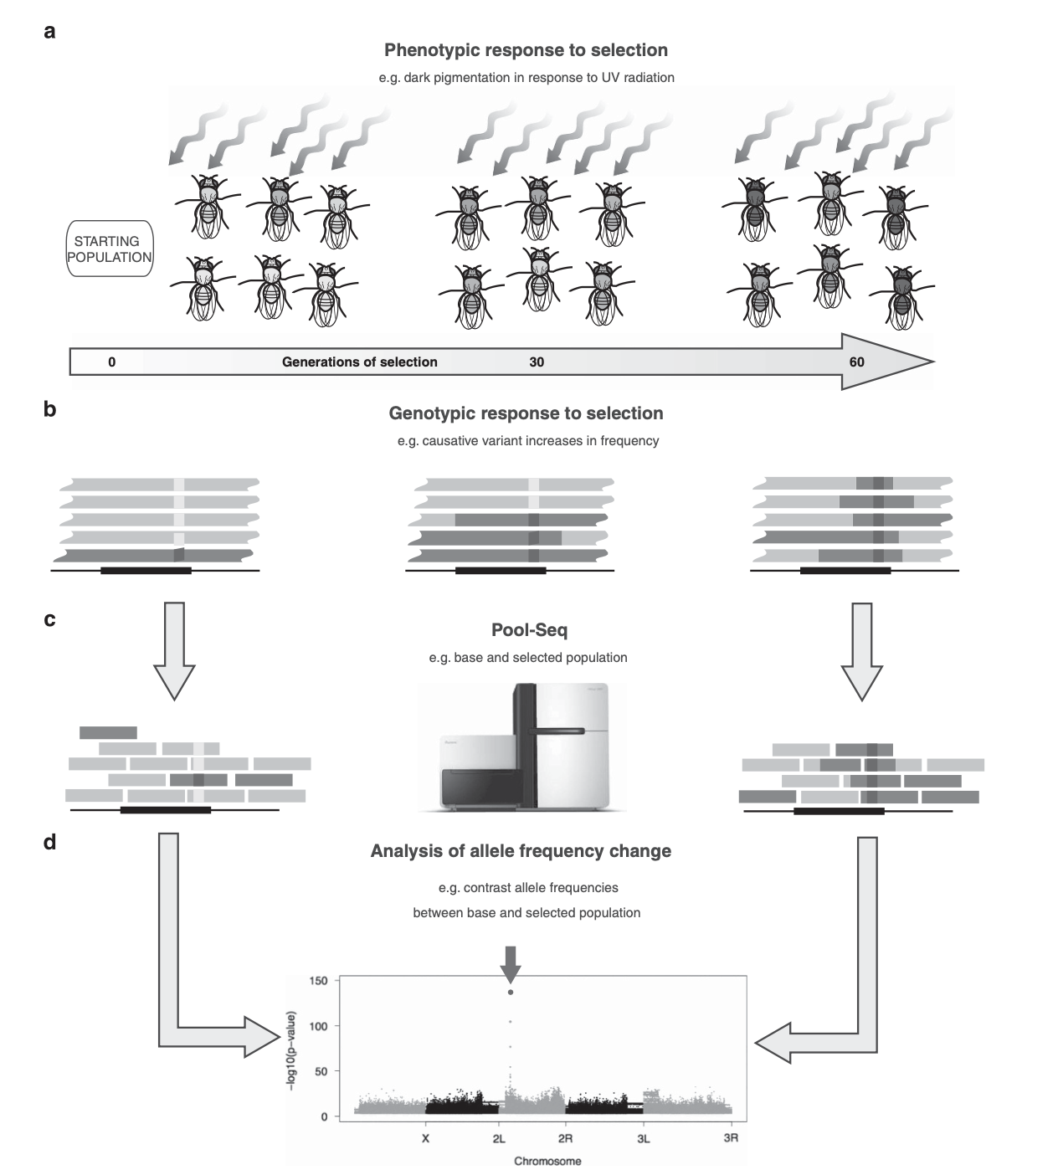
https://www.nature.com/articles/hdy201486

Slide 6
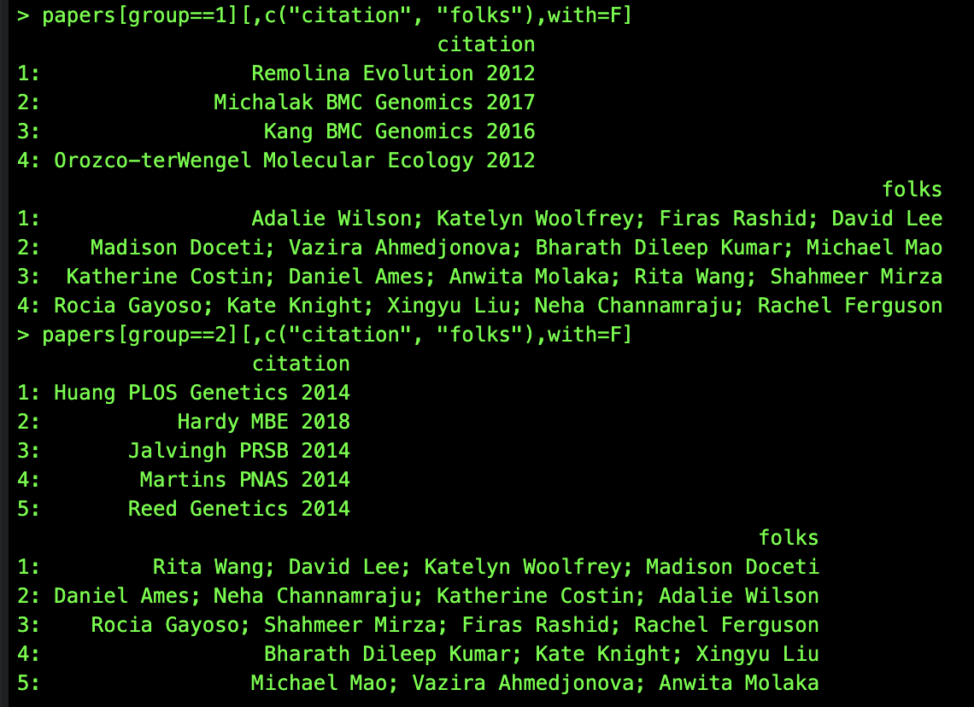
1) What are the basic questions that the authors are asking?
2) Why do the authors think that these are important questions?
Discussion of papers:

Slide 7
Paper | 1) What are the basic questions that the authors are asking? | 2) Why do the authors think that these are important questions?
Burke Nature 2010 | Evolution of development time
Remolina Evolution 2012 | Genetic basis of aging and life-history evolution; late-life fecundity | Tradeoffs between life-history traits are prevalent across the tree of life
Michalak BMC Genomics 2017 | How does nucletotide diversity change in response to selection on lifespan | How pleiotropic are alleles and does it affect evolution of aging?
Reed Genetics 2014 | How do genetic and environmental factors affect transcription and metabolomics and intersect with evolutionary change | How much GxE is there for metabolic syndrome? Identify targets for evolution and therapudics
Kang BMC Genomics 2016 | What genes are responsible for adaptation? What are signatures of selection at nucleotide? | What are the consequences of selection on genetic diversity?
Orozco-terWengel Molecular Ecology 2012 | What is the evolutionary trajectory to temperature? | Do observations agree with theory about selective sweeps?
Huang PLOS Genetics 2014 | How environmental heterogeneity affects diversity: spatial vs temporal | Do observations agree with theory about mechanisms that promote diversity?
Hardy MBE 2018 | What are the metabolic and physiological consequences of resistance to starvation selection esp as it relates to obesity | Multiple mechanisms of evolution of starvation resistance and relationship to humans.
Jalvingh PRSB 2014 | What are the genes involved in Immune system evolution ? | Immunity matters.
Martins PNAS 2014 | Host adaptation to viruses and whether genes are involved in cross resistance | Are there limitations and tradeoffs to resistance?

Slide 8
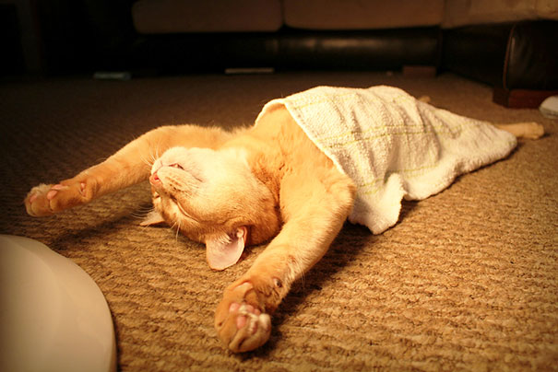
Break

Slide 9
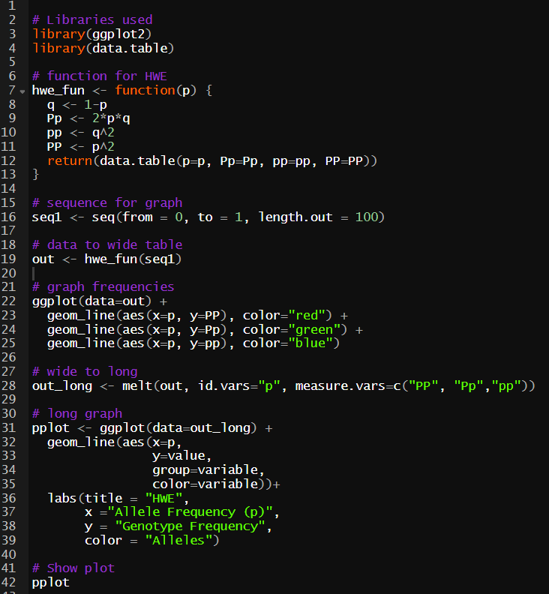
Code submission guidelines
Streamlined script
Coding best practices
Code is functional.
Annotations are included (e.g., line 6).
Code is not excessively redundant.
Code does not contain errors.
(this is an example if an ideal submission)

Slide 10
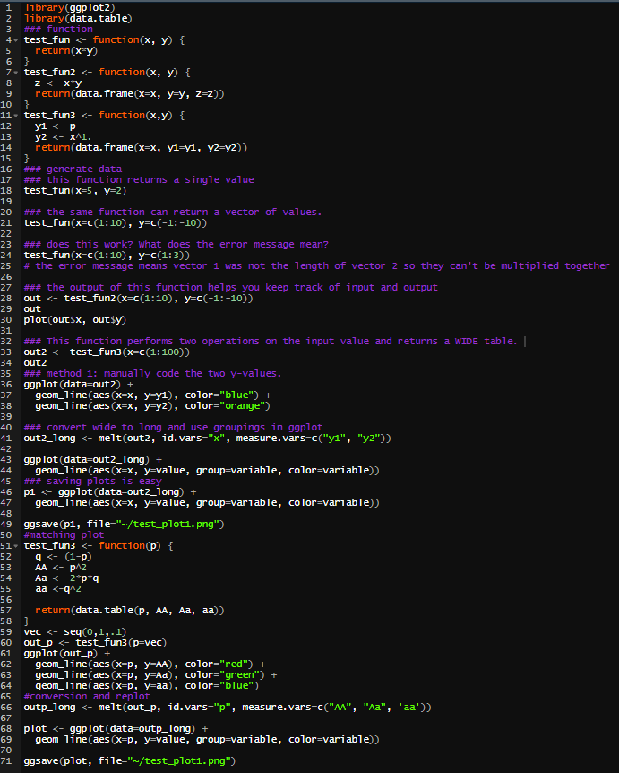
Code submission guidelines
Things to look out for
Lack of meaningful annotations.
Code is long and kind of complex.
Code may contain errors.
Code overwrites existing variables.
(this is an example of a messy submission)

Slide 11
Checklist rubric for code:
Code contains annotations and comments to help readability.
Code has date, name, and functional descriptors near the top of the script.
Code is functional and completes an obvious goal.
Code is efficient and completes tasks in reasonable amounts of time.
Code does not contain errors or typos.
Code is a reasonable length and does not contain overly repetitive segments.
Code does not rely on many external packages.
Code is modular and flows logically.
Code produces a figure or table of results.
Code is reproducible and writes the finalized output.
Code is uploaded to your personal GitHub.

Slide 12
WF simulation
• One of the common themes of the papers that we read over was that scientists were trying to identify changes in allele frequency that were greater than expected by drift.
• Artificial selection often uses smaller populations (much smaller than natural populations). Therefore, if you are interested in identifying targets of selection you need to be able to evaluate the role of drift. Is drift alone causing allele frequency change?
• To begin to answer this question, we need to learn how to model drift. Our goal from this assignment will be to generate the classic drift figure.

Slide 13
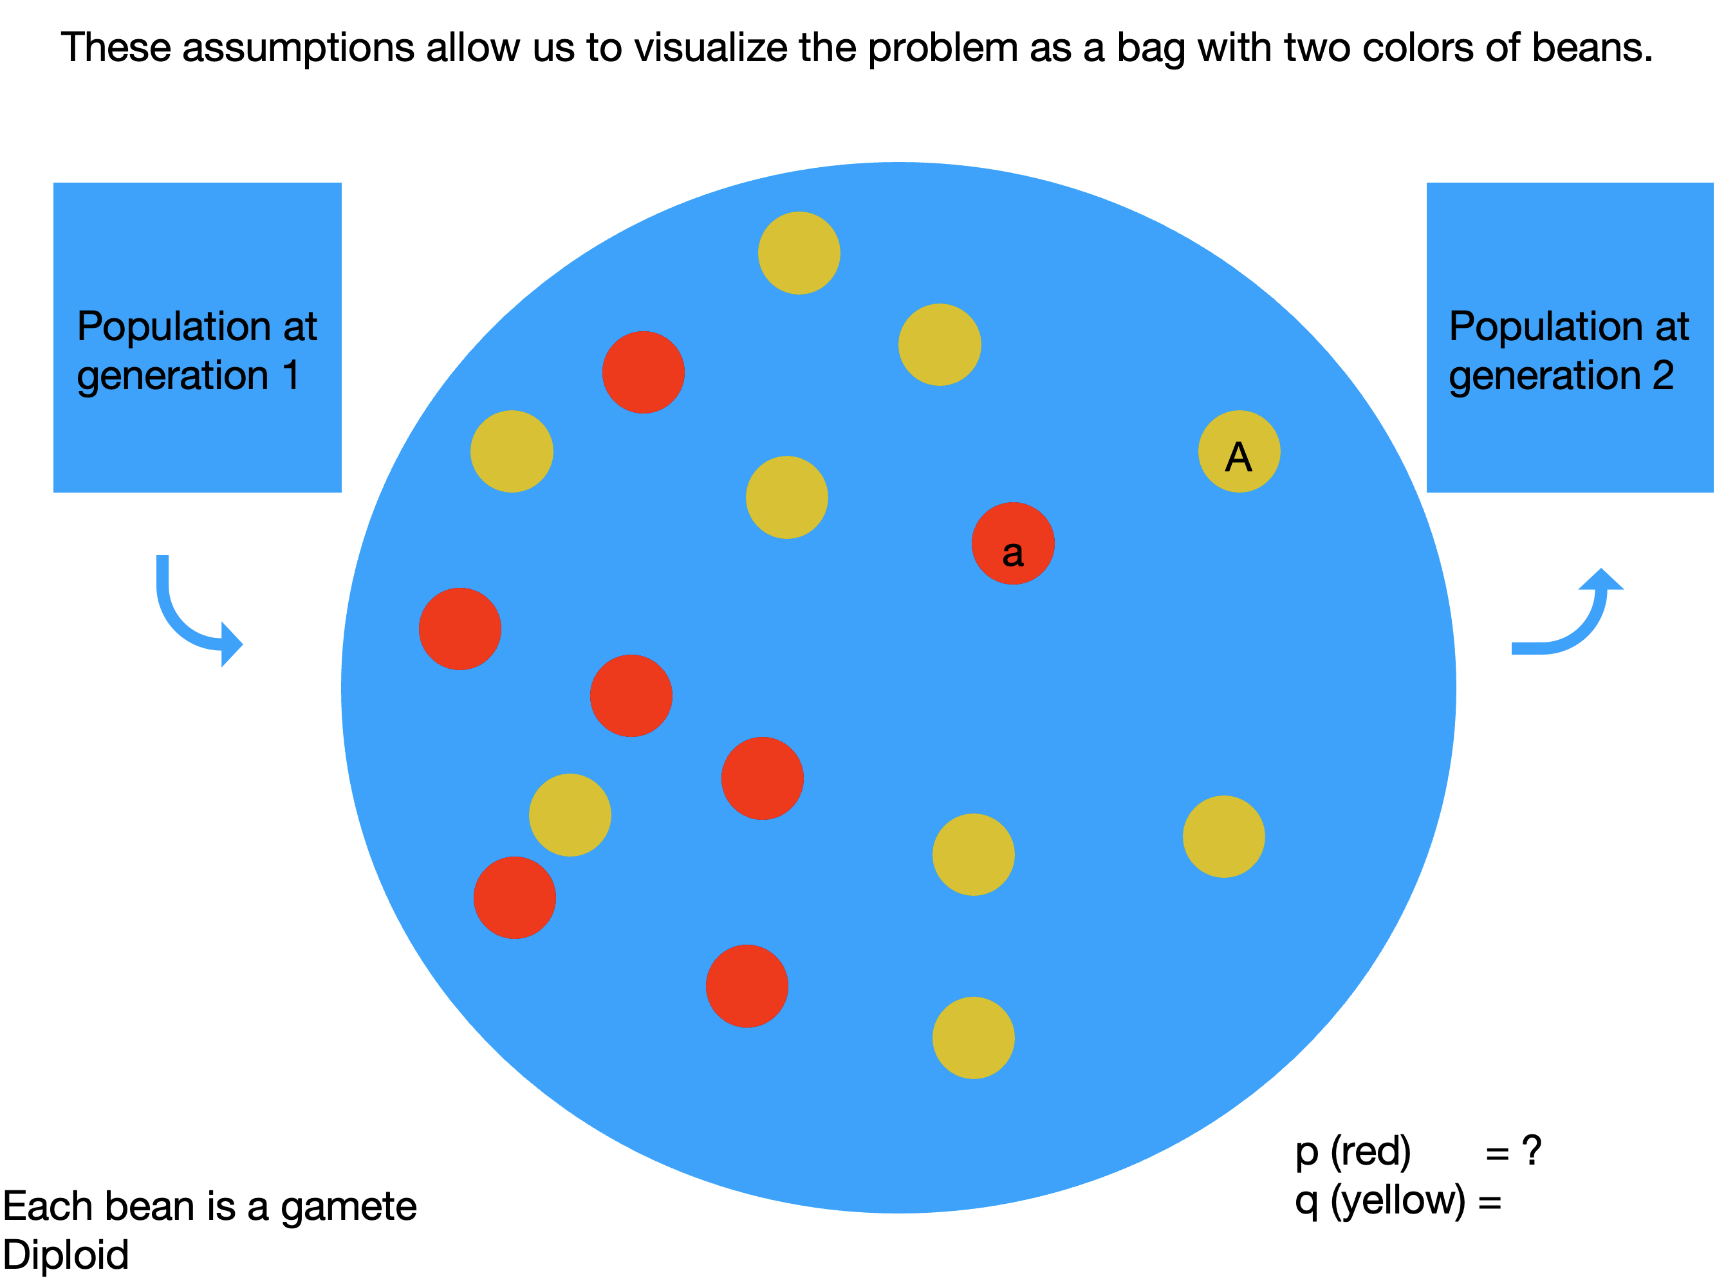

Slide 14
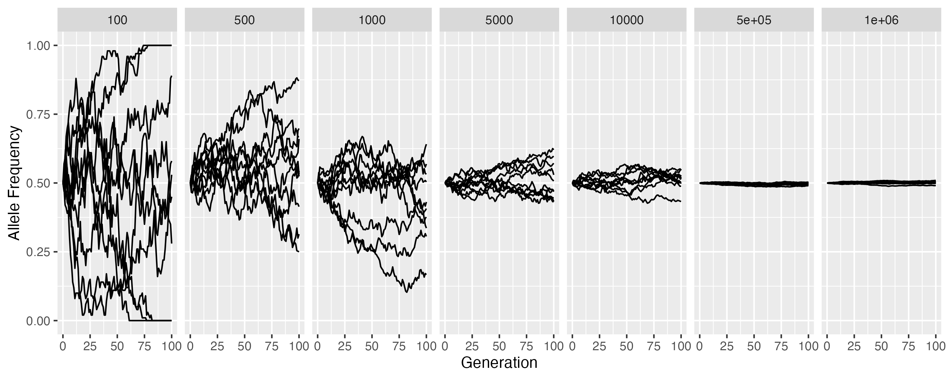
What are the facets? What is the x– and y-axis? What are the lines?
The goal of this assignment is to recreate this figure.

Slide 15
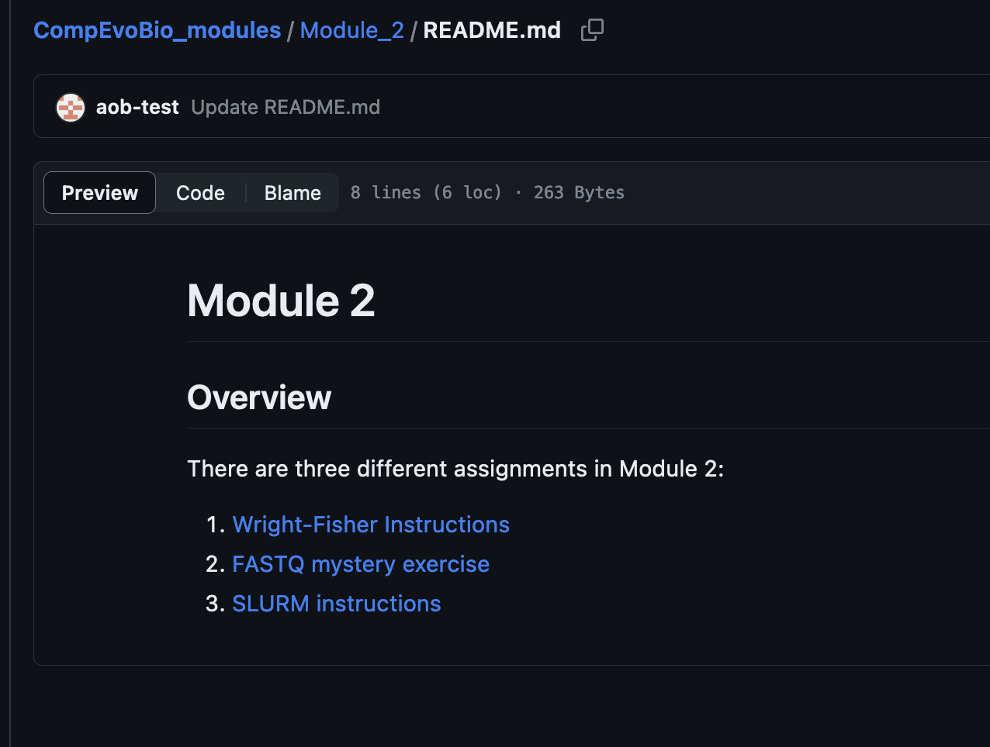
Work on the instructions to the assignment on GitHub

Slide 16
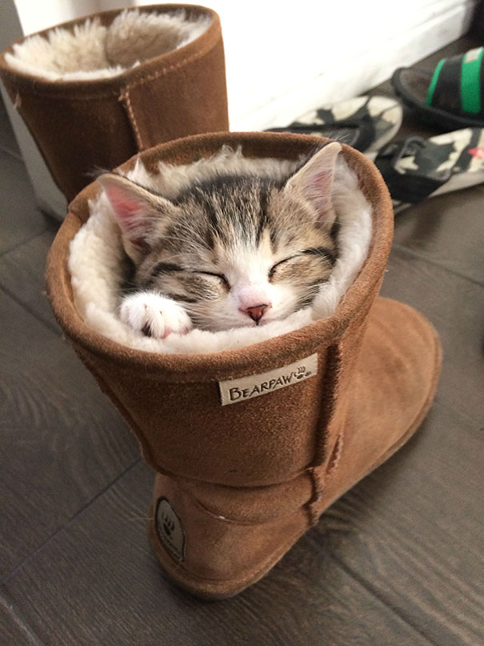
Break

Slide 17
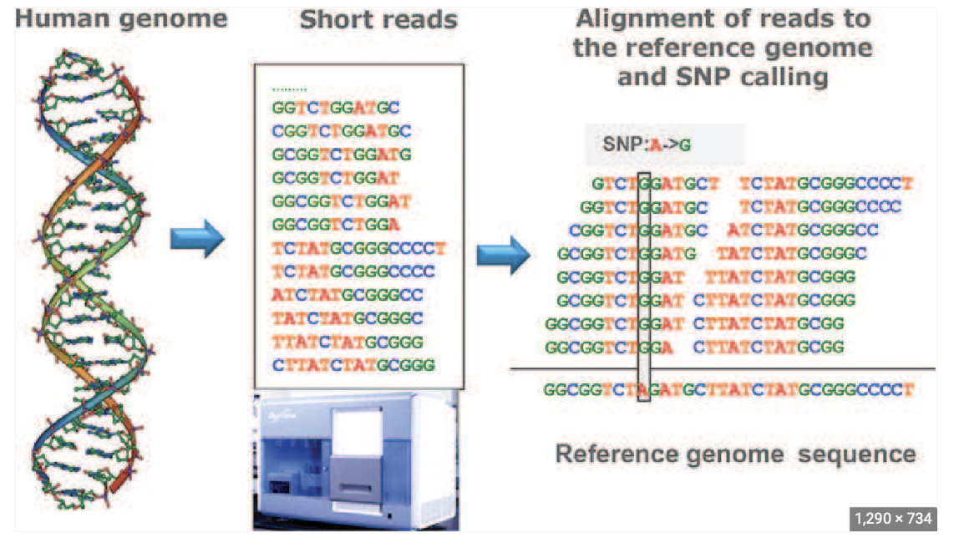

Slide 18
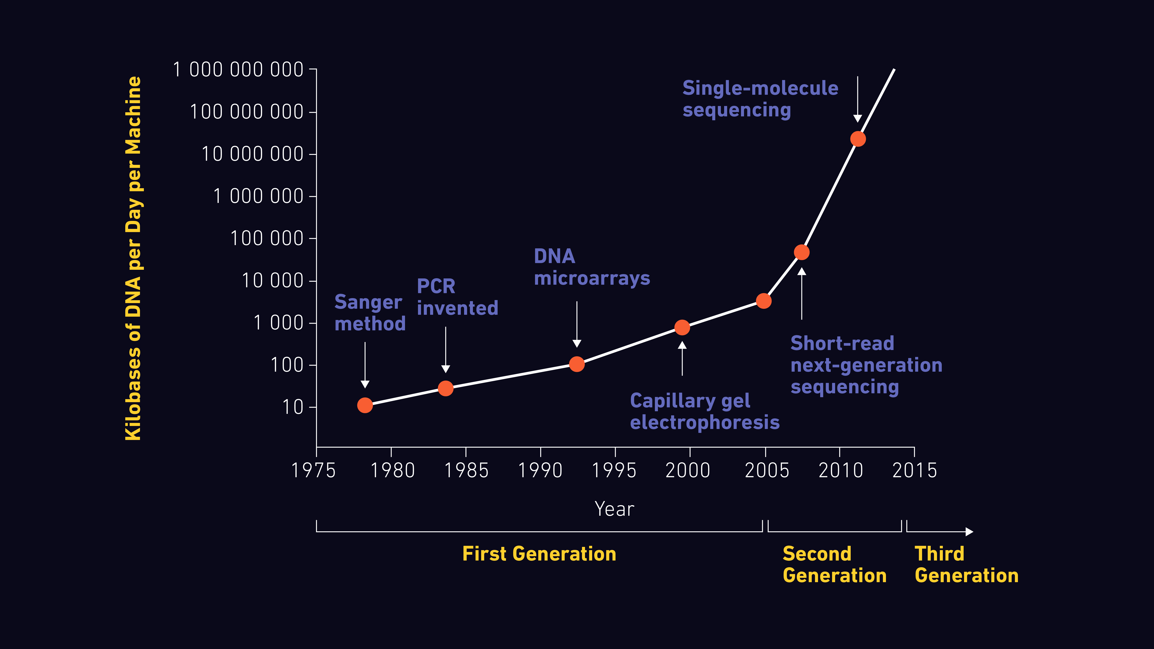
Short read data
https://www.technologynetworks.com/genomics/articles/an-overview-of-next-generation-sequencing-346532

Slide 19
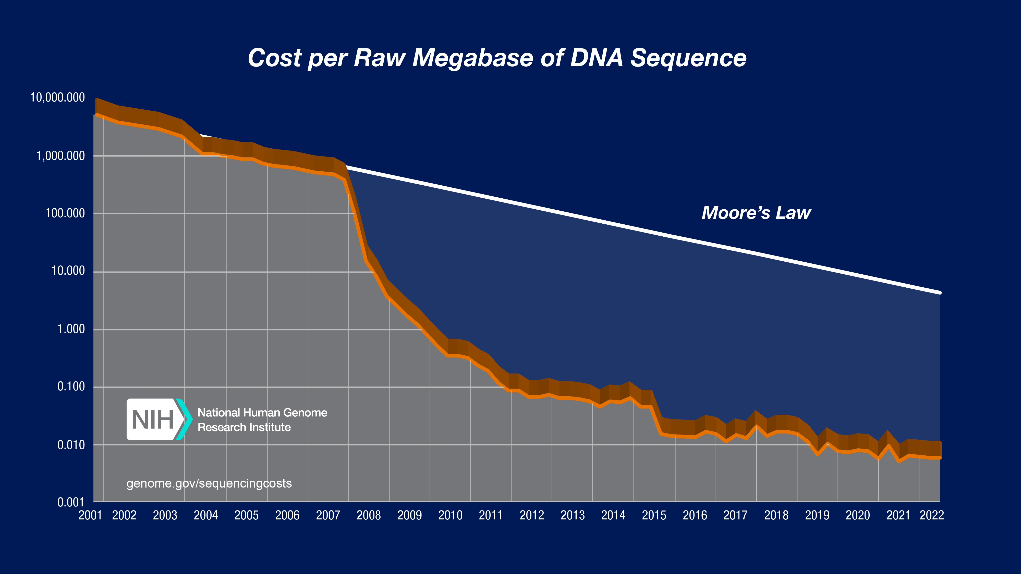

Slide 20


Slide 21
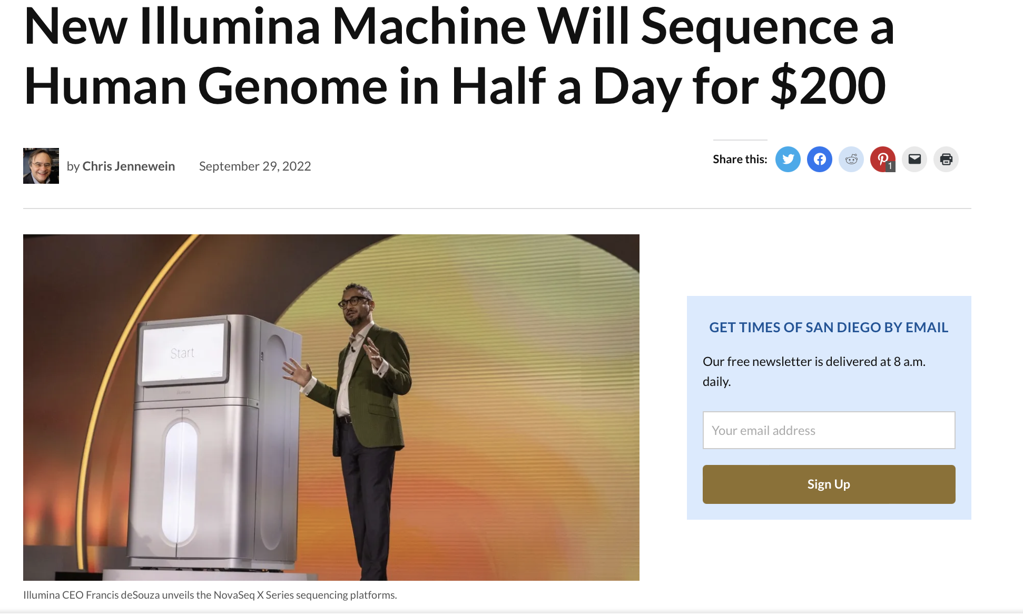

Slide 22
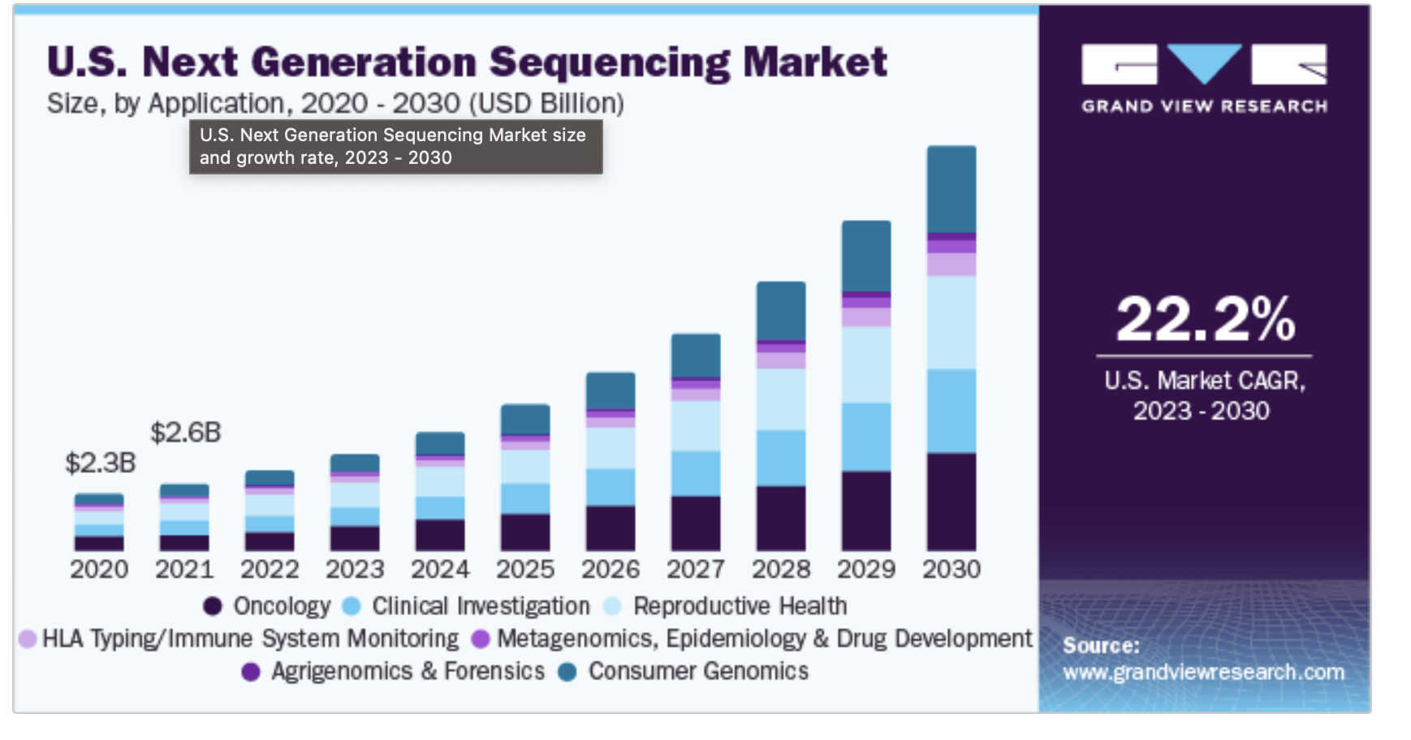

Slide 23
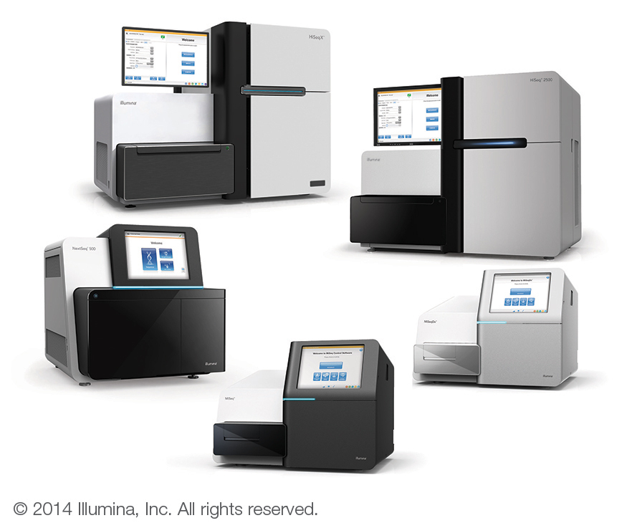
Over 1000X increase in sequencing capacity over the last 10 years….

Slide 24
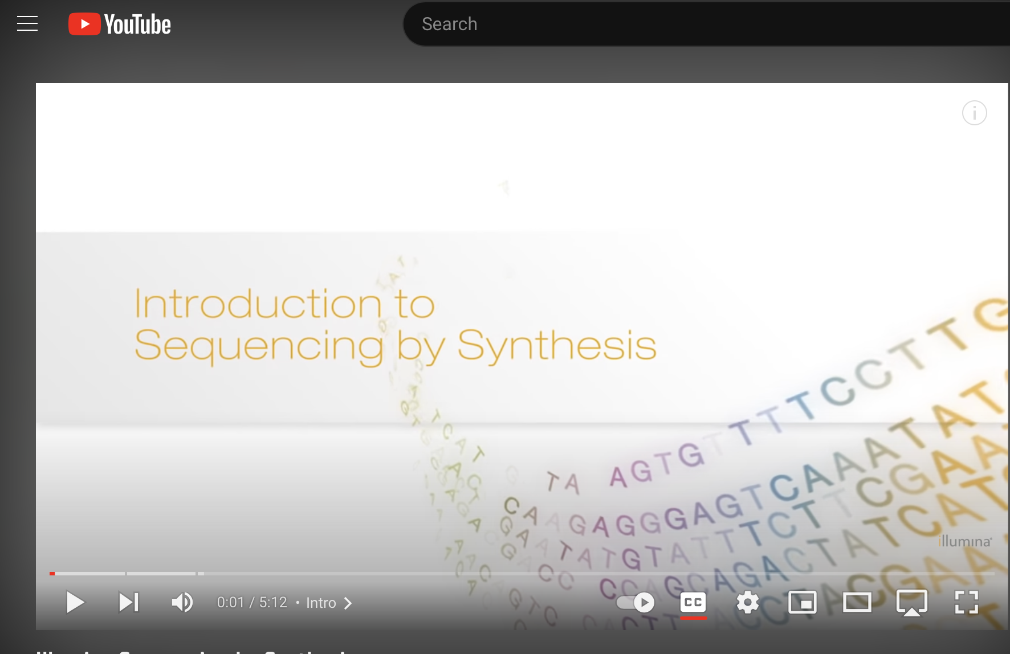
How does Illumina Seq work?
https://www.youtube.com/watch?v=fCd6B5HRaZ8

Slide 25
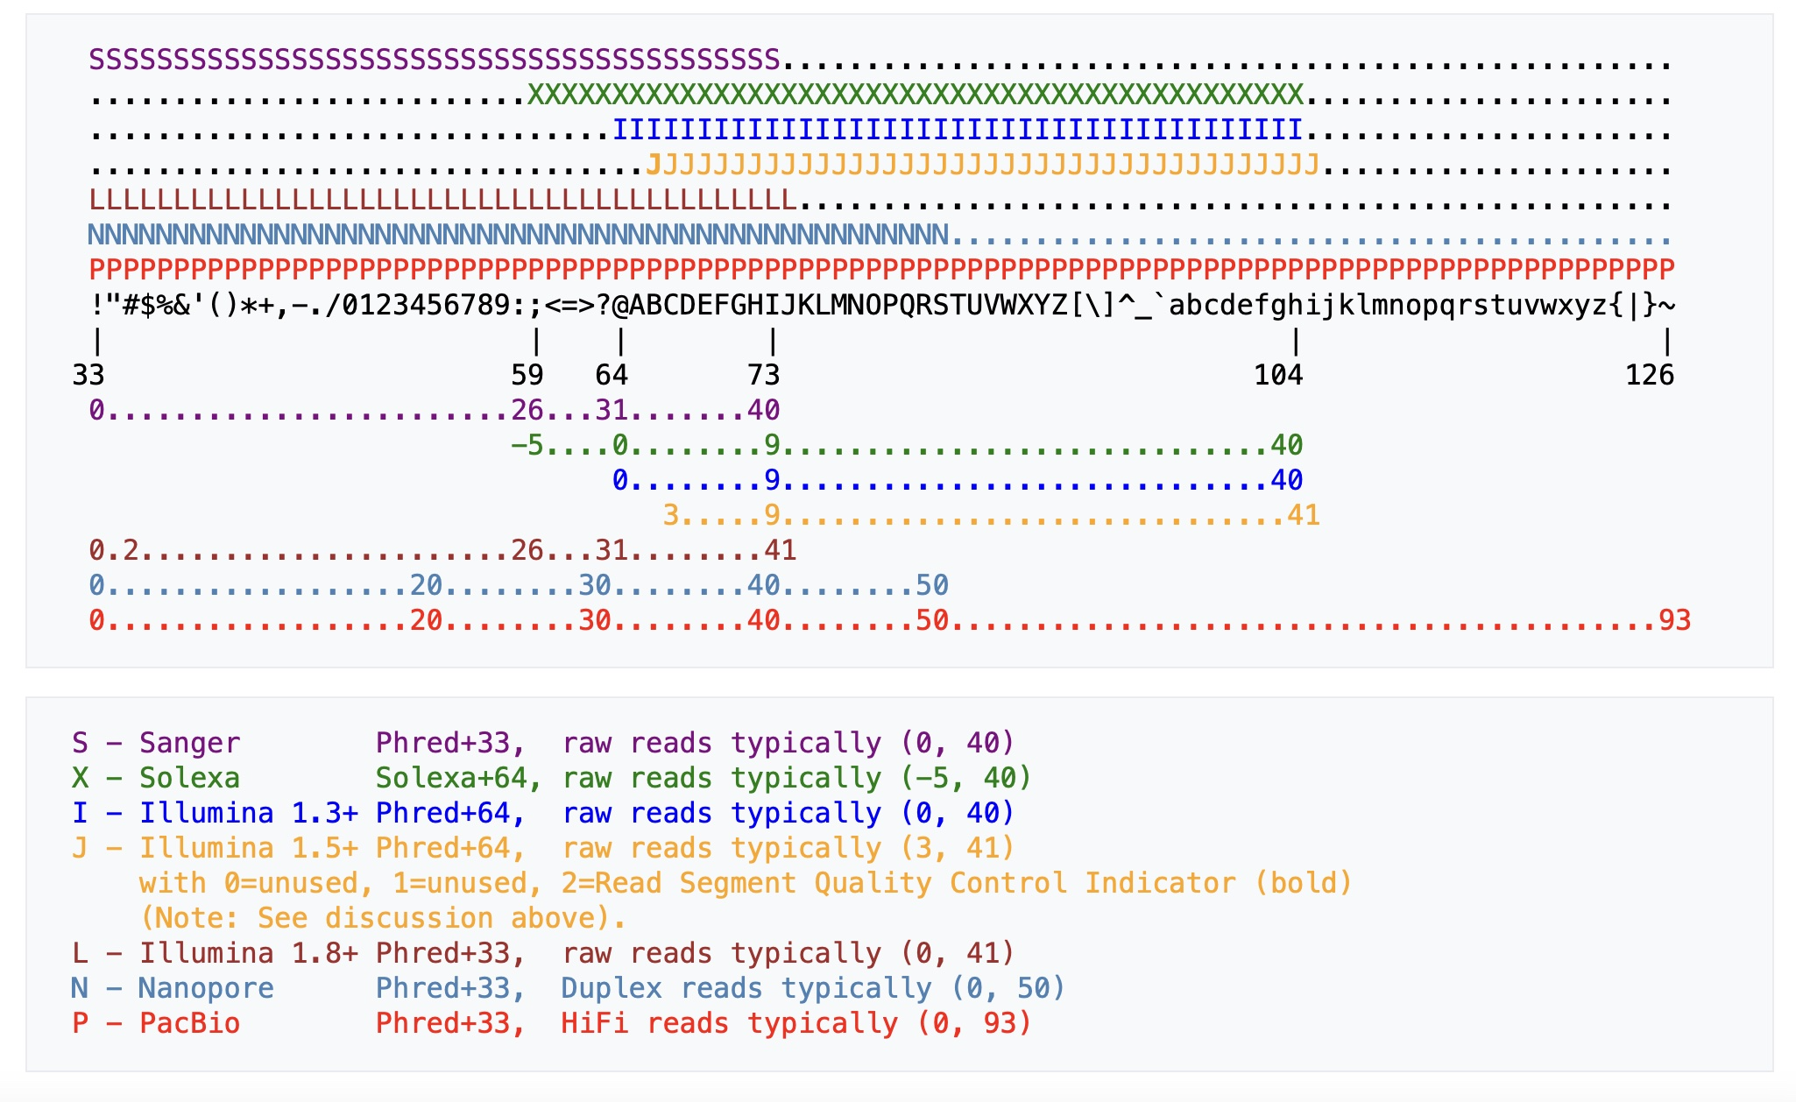
FASTQ exercise
Goals)
Practice on the terminal
Solve two technical mysteries of sample FASTQ files

Slide 26
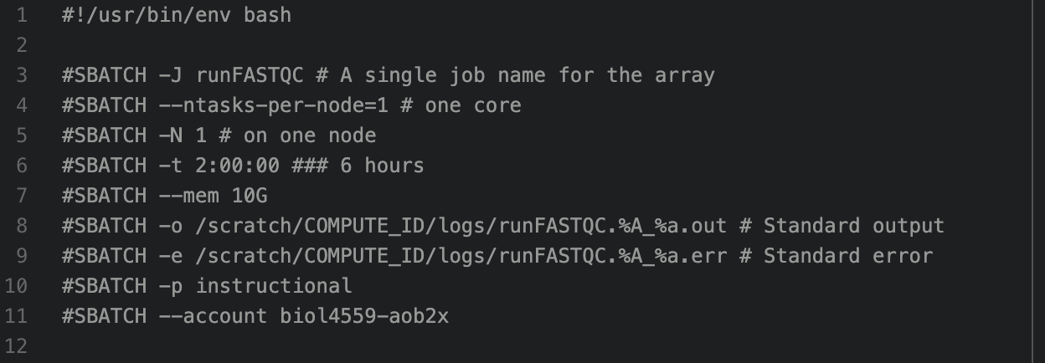
SLURM exercise
• In the exercise, we have two goals:
1) Learn how to submit jobs to Rivanna using SLURM
2) Run FASTQ report on your samples

Slide 27
